Slide 1
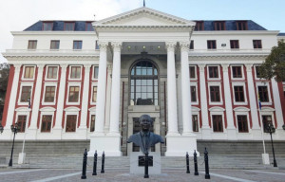
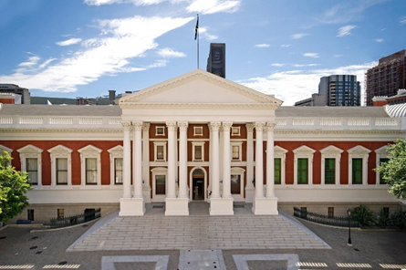
HANSARD
Hansard reporting in a multilingual context
&
Our Experience Using an Automatic Speech Recognition System

Slide 2
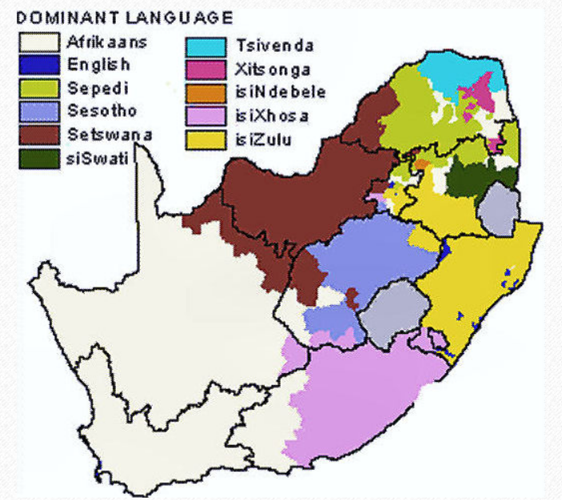
The Constitution of the Republic of South Africa recognises 12 languages as official languages of government (10 spoken languages indigenous to the country, plus English, plus Sign Language)
isiZulu (22,7%)
isiXhosa (16%)
Afrikaans (14,5%)
English (10,6%)
Sepedi (9,1%)
Setswana (8%)
Sesotho (7,6%)
Xitsonga (4,5%)
siSwati (2,5%)
Tshivenda (2,4%)
isiNdebele (2,1%)

Slide 3
MANAGING MULTILINGUAL REPORTING – TWO BROAD FOCI:
Recruitment and Selection model
Workflow + Performance management systems

Slide 4
RECRUITMENT AND SELECTION
staff establishment
recruitment model
linguistic overlap
vastly differing levels of reporter ability

Slide 5
THE IMPLICATIONS OF OUR RECRUITMENT MODEL
Scenario 1: An MP whose mother tongue / first language is not English delivers a speech in English during a sitting
That MP’s speech is reported by a reporter whose mother tongue / first language is not English and who is multi-lingual
Scenario 2: An MP delivers an off-the-cuff speech in his / her mother tongue during a sitting, but code-switches between his mother tongue and other indigenous languages

Slide 6
MANAGING MULTILINGUAL REPORTING – TWO BROAD FOCI:
Recruitment and Selection model
Workflow + Performance management systems

Slide 7
WORKFLOW + PERFORMANCE MANAGEMENT
Logging
Allocation
Pre-independence and Independence
Checking and Mentoring
Two levels of quality assurance
Standard Operating Procedures
Quality assurance is integrated into Parliament’s Performance Assessment and Management system
Circles of professional development – formal & informal
WF
PA
QUALITY

Slide 8
HOLISTIC QUALITY ASSURANCE
1: An MP whose mother tongue / first language is not English speaks English during a sitting
That MP’s speech is reported by a reporter whose mother tongue / first language is not English
Challenge addressed operationally – inclusion of indigenous language experts; SOPs; two levels of quality assurance
Challenge is addressed systemically – personal development plans on the Performance Management system
2: An MP code-switches between his mother tongue and other indigenous languages
That MP’s speech is reported by multilingual reporter

Slide 9
TRIALLING AN AUTOMATIC SPEECH RECOGNITION SYSTEM FOR ONE MONTH IN 2021 – OUR FINDINGS:
Helpful
Quite impressive!
Varying levels of transcription accuracy – what are the reasons?
Human editorial intervention
ASRs for languages used less frequently in government – audio recordings
Logical progression of ASR development?

Slide 10
Thank you

