Slide 1
Speech recognition in the Folketing Hansard
CHEA conference, session 3
July 13, 2022
Lars Busch Nielsen

Slide 2
The scope our work
100-115 sittings a year in the chamber
600-800 sitting hours per session
No fixed end time of a session – usually 4-7 hours

Slide 3
Who are we?
1 head of department
1 editor (Michael Ejstrup)
22 reporters (most with a university degree in language studies)

Slide 4
The first version of the report
Logging
Picking a sequence
Respeaking
Online publishing
Notes:
How do we produce the report?
We use a speech recognition system to produce the report, i.e. we dictate the speeches instead of typing them.
The production of the report is carried out in four steps.
Speech list: A reporter is always present in the chamber when a sitting is in progress. The reporter makes a time stamp for each speaker under the appropriate item on the agenda and provides the relevant information about the speaker (e.g. if he or she is a party spokesperson). In this way we are provided with a speech list in chronological order.
The reporters in chamber work by rotation whereby each sits in the chamber for one hour. 2 or 3 reporters generally share one sitting and all reporters in chamber have one shift a week with the possibilty of swapping shifts and covering for each other in case someone is absent.
2. Picking a speech: The reporter picks a coherent work sequence, such as a spokesman’s speech or an exchange between two speakers/a set of short remarks, from the speech list. The work sequence is then transferred to the speech allocation interface, the so-called transeditor.
3. Transediting: The reporters dictate the speeches segment by segment while at the same time correcting grammatical and syntactical errors. They then postedit the speech and listen to it one more time.
(We call this work process transediting because it combines two functions, namely transcribing and editing.
It normally takes 1-1½ hours to transedit a 5 minute speech, depending on the linguistic difficulty of the speech and the amount of facts and quotes which need to be checked. Our statistics show that it generally takes 18 minutes to transedit a 1 minute speech (however, these statistics also include the time used on other tasks and short breaks).
4. Publishing on the internet: After having completed a work sequence, the reporter releases it to the internet by pushing a button. In this way the report is published online gradually – i.e. sequence by sequence - and congestions in the system are thus avoided as the sequences do not have to be published in chronological order.
The work sequence does not have to be read through and approved by another reporter before publication.
Neither does the report require approval from the Members.
When the report has been released to the internet, the preliminary edition is complete. In order to emphasize its preliminary status, a watermark with the word ”preliminary” is placed across each page.
Our work method differs from many others’ in that we do not work by a fixed rotation; the reporters have not been present in the chamber during the delivery of the speeches in their chosen sequence. They simply pick the speeches in chronological order as they become available on the speech allocation interface.
When the reporters in chamber are not present during the sitting, they join in the work with the report, but, like anybody else, they pick their work sequences in chronological order, so if they find themselves editing something they have witnessed in the chamber, it is purely coincidental.

Slide 5
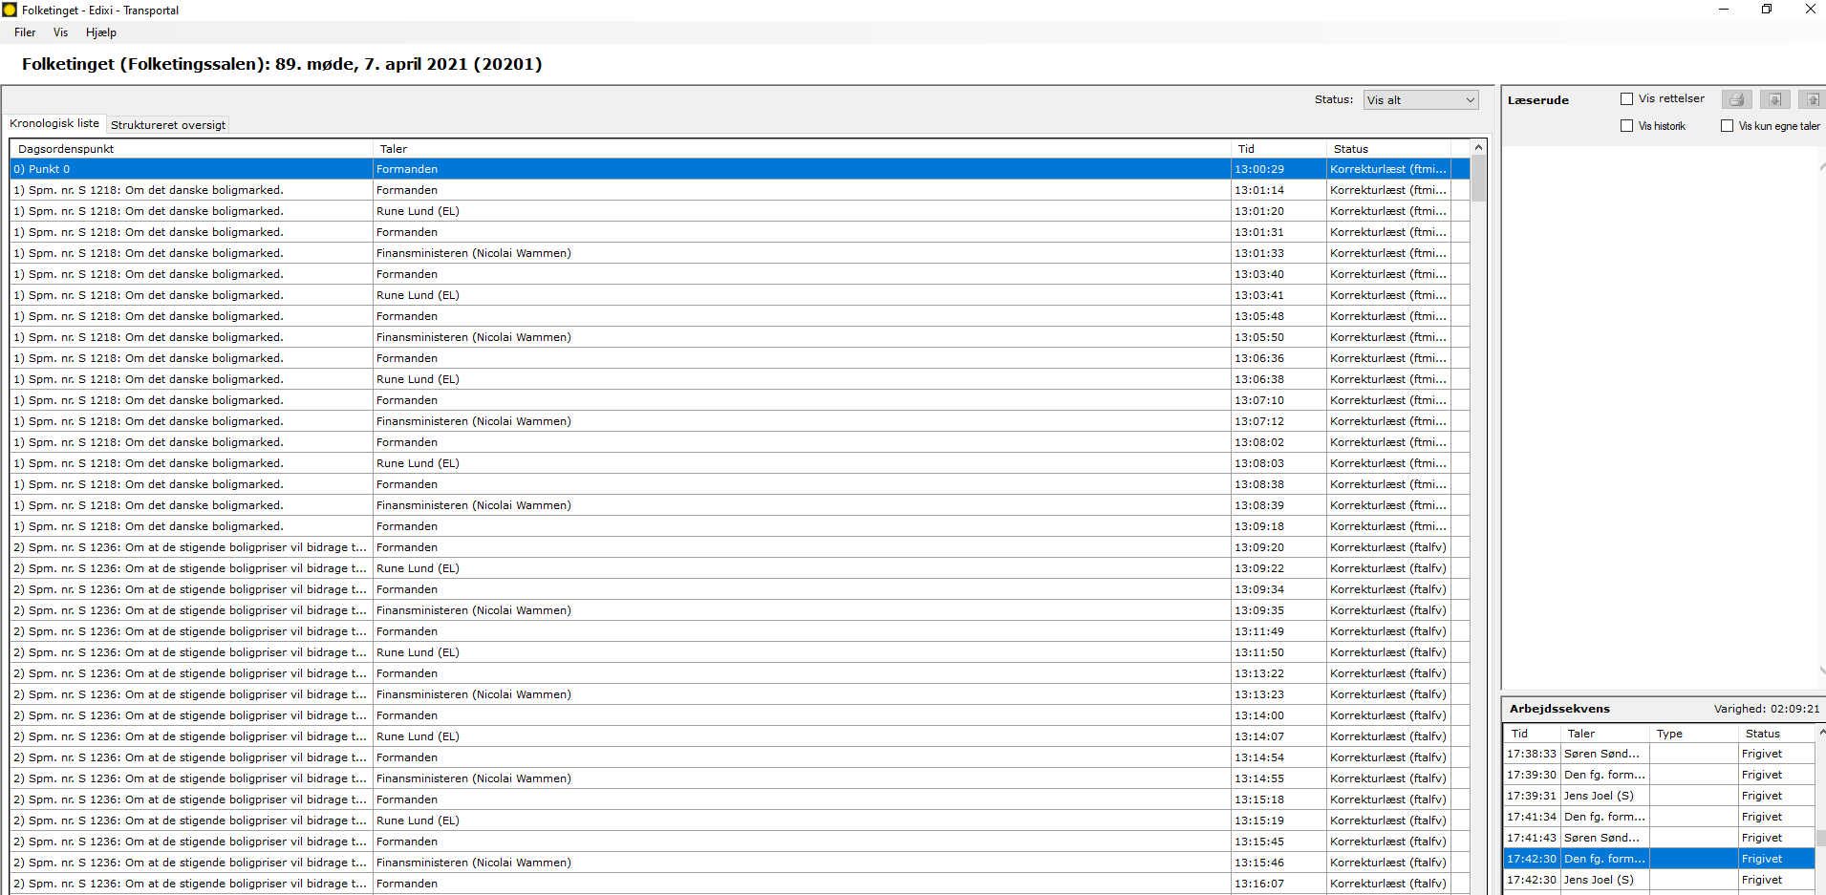
Logging a sitting in the chamber

Slide 6
Respeaking with Dictus SUN
Speaker independent programme
95+ percent correct recognition
Dictating and editing in one go
Why not ASR?

Slide 7
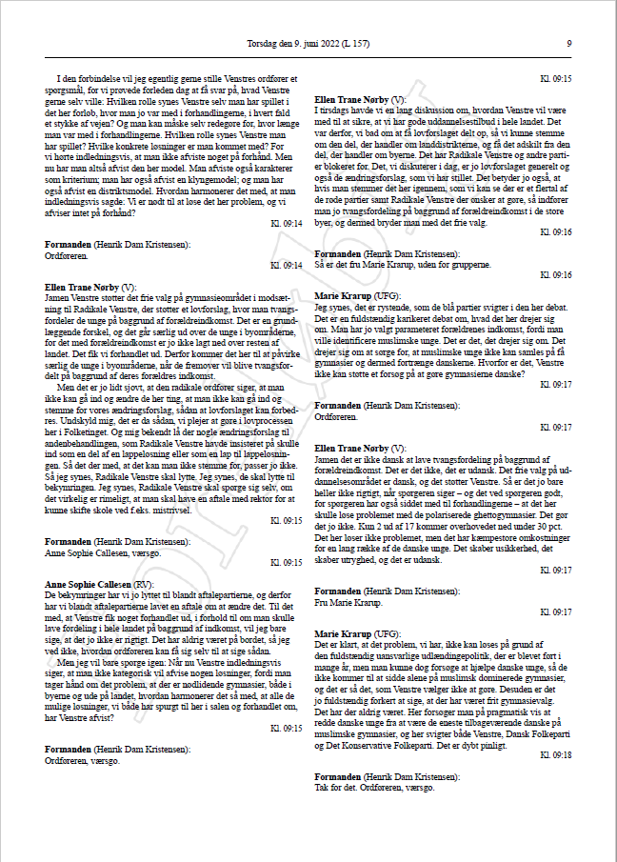
Our publications ”Folketingstidende” (Hansard) and www.folketingstidende.dk
”Folketingstidende” was published on paper until 2008-09.
Digitized back to 1849.
Only published online on www.folketingstidende.dk since 2009.

